Slide 1




PRESENT BY
MOHAMMAD MUJTABA
PHIP-PHASE-I
COURSE :WEB DEVELOPMENT
LEAD : SIR AMEER AMANULLAH
CO TRAINER : SIR SHAYAN KHAIKH

Slide 2
CAMPUS CONNECT HUB — FULL ROLE RELATIONSHIP SYSTEM
Multi Purpose University - Combine Portal For everyone
Objective
The main objective of the University Contact Hub website is to create a centralized digital platform where students, faculty, and administrative departments can easily connect and communicate.
The system aims to simplify access to contact details, announcements, and departmental information, promoting efficient interaction and collaboration within the university community.

Slide 3
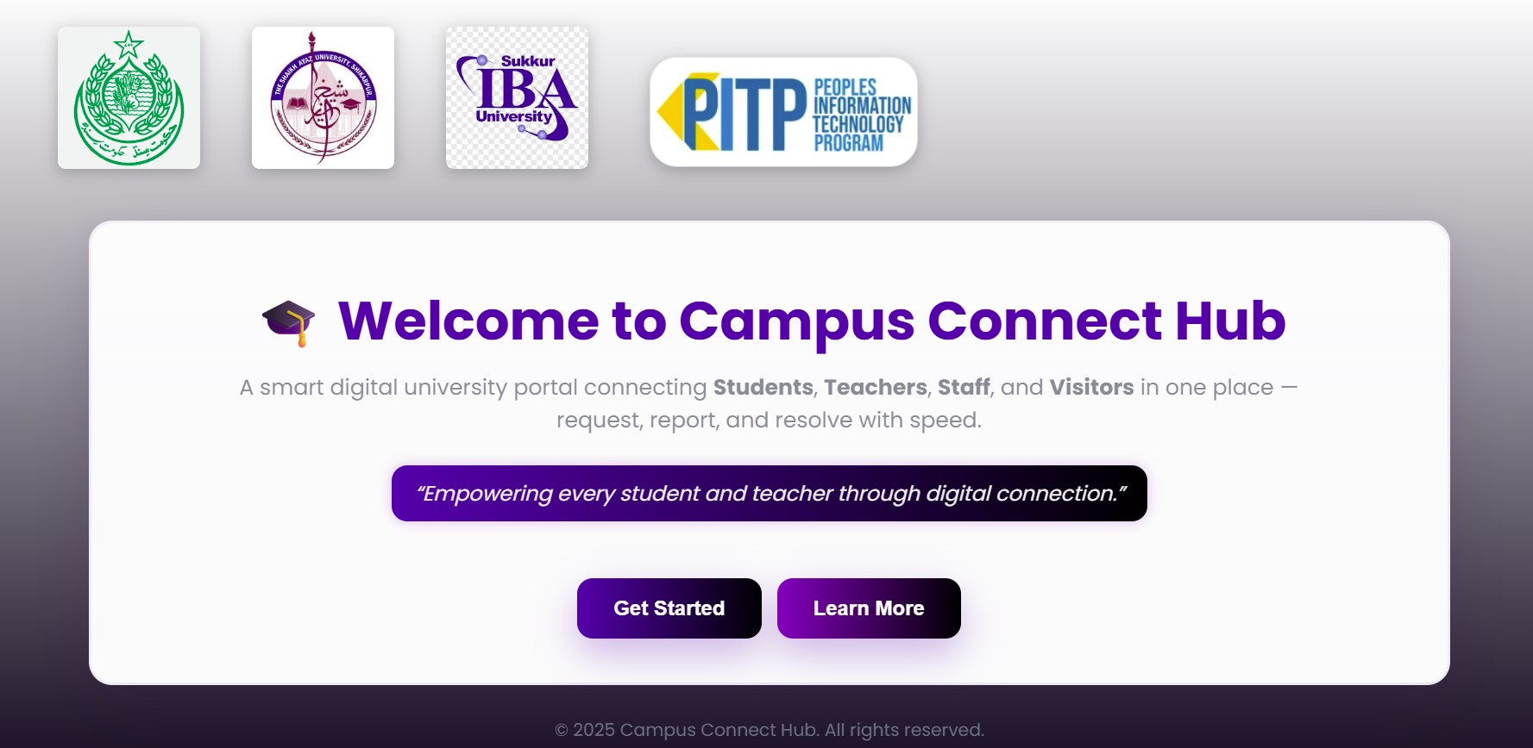

Slide 4
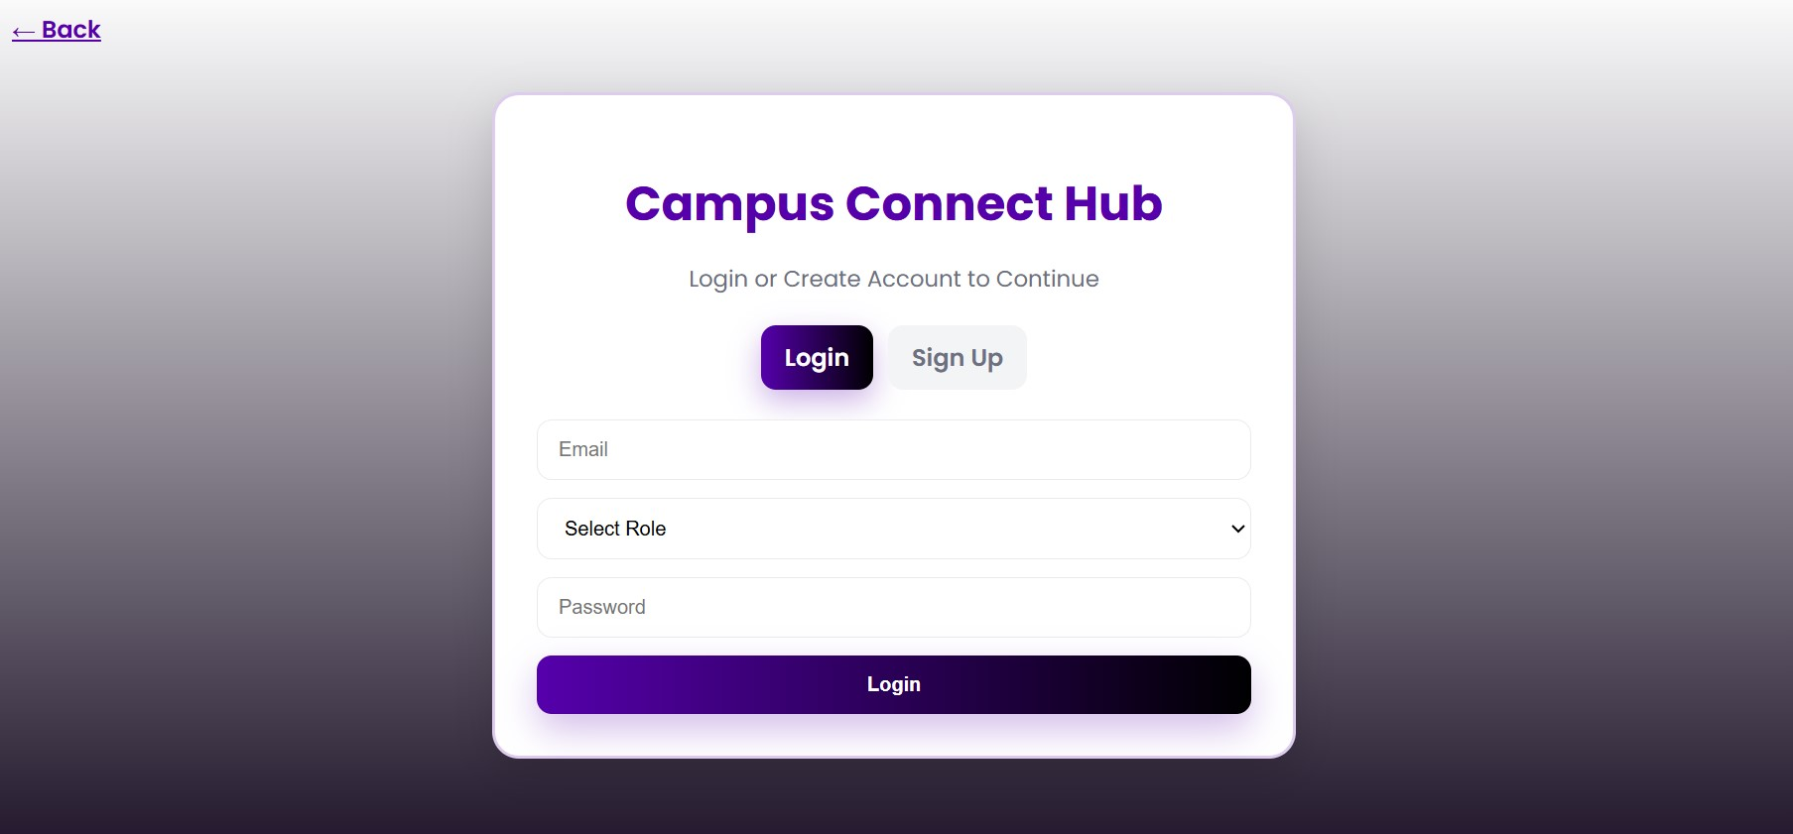

Slide 5
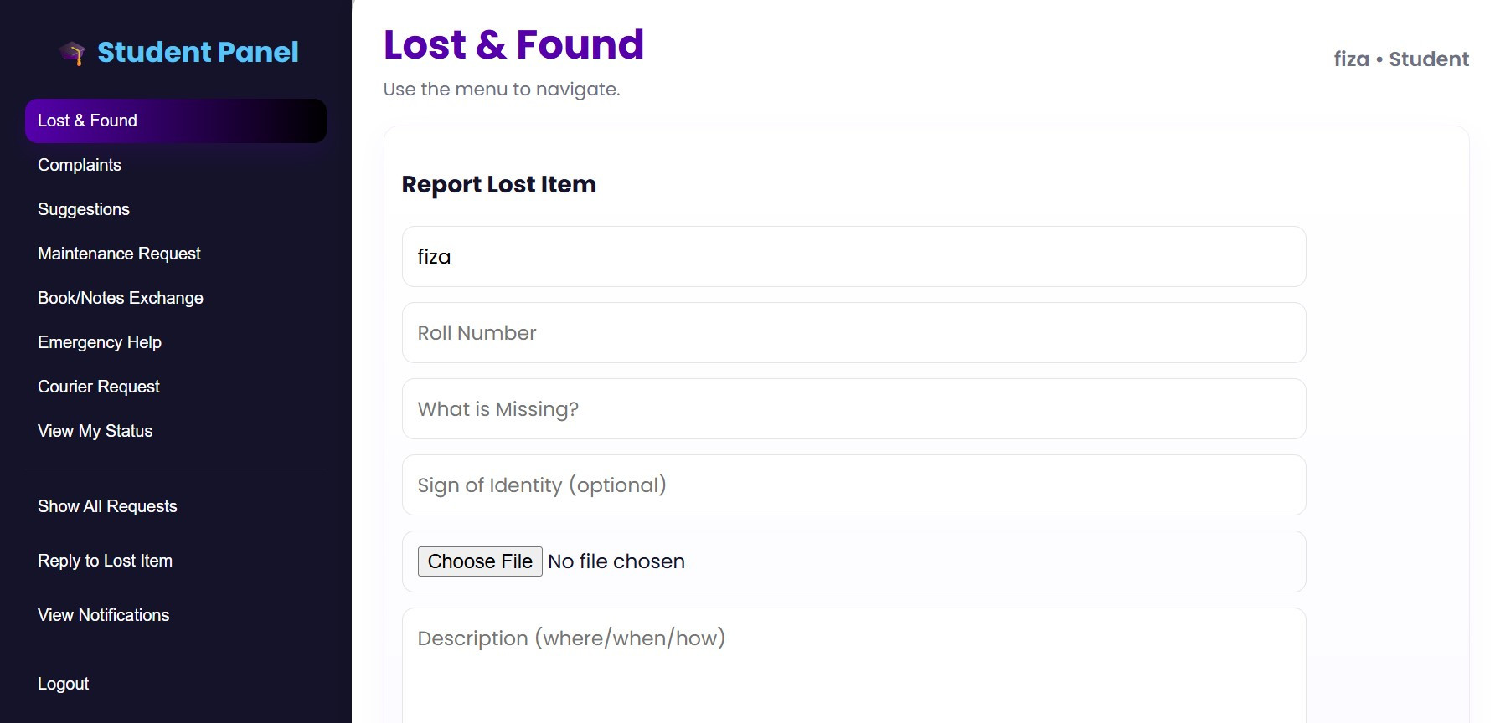

Slide 6
1. STUDENT ROLE
Feature / Option | Description | Goes To (Receiver) | Seen By
Lost & Found | Reports lost items like ID, wallet, bag | Lost & Found Staff | Staff (Lost Desk), Student (for update)
Complaint | Complains about Wi-Fi, fan, class issues | Admin / Maintenance Staff | Faculty/Admin
Suggestion | Gives ideas for improvement | Admin / Management | Admin
Book / Notes Exchange | Offers or requests notes/books | Library Staff / Students | Library Staff, Other Students
Maintenance Request | Broken chair, light, projector issue | Maintenance Staff | Maintenance Staff
Emergency Help | First aid or medical alert | Medical Staff | Medical Staff, Admin
Courier Request | Sends notes/items across campus | Courier Desk Staff | Courier Desk, Student
View Status | Check progress | Self(Read-only) | Only that student

Slide 7
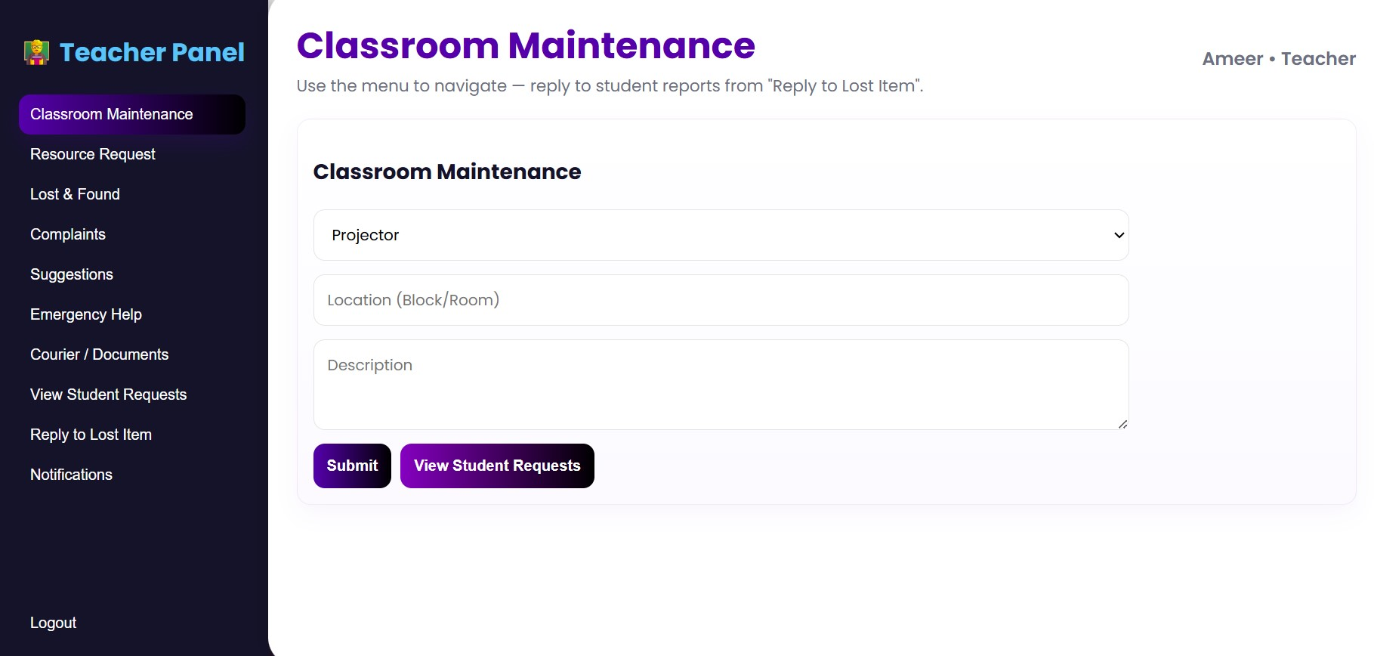

Slide 8
2. TEACHER ROLE
Feature / Option | Description | Goes To (Receiver) | Seen By
Classroom Maintenance | Projector/light repair | Maintenance Staff | Maintenance Staff
Resource Request | Need markers, sheets, IT help | Admin / IT Staff | Admin, IT
Lost & Found | Lost teaching material | Lost & Found Staff | Lost Desk
Complaint | Schedule / system issue | Admin / Department Head | Admin, Department Head
Suggestion | Timetable, course improvements | Management / Admin | Admin
Emergency Help | Medical case in class | Medical Staff / Admin | Medical Staff
Courier / Document Transfer | Send admin forms | Courier Desk / Admin | Courier Desk
View Student Requests | Read-only access | System Filtered | Teacher only

Slide 9
3. FACULTY / ADMIN STAFF ROLE
Feature / Option | Description | Receives From | Can Send/Forward To
View & Manage All Requests | Dashboard of all student/teacher/public reports | All Roles | None (View + Update)
Complaint Handling | Manage complaints | Students, Teachers | Admin Head / Maintenance
Lost & Found Verification | Approve claims | Students, Teachers, Public | Admin
Maintenance & Technical Requests | Handle all facility repairs | Students, Teachers | Maintenance Dept.
Emergency Dashboard | See emergencies | Students, Teachers, Public | Medical Team
Public Queries | Handle public messages | General Public | Info Desk / Security
Update Status | Mark resolved or pending | All Roles | System updates automatically
Generate Reports | Summary view | Local Data | Only staff

Slide 10
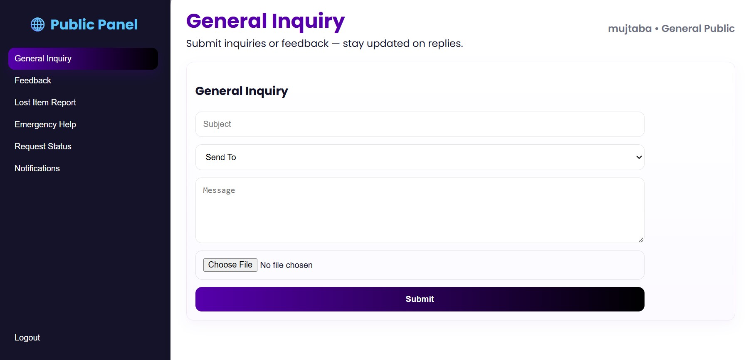

Slide 11
4.GENERAL PUBLIC ROLE
Feature / Option | Description | Goes To (Receiver) | Seen By
General Inquiry | Ask about admission, hours | Info Desk Staff / Admin | Admin
Lost & Found (Public Area) | Report items in open area | Security / Lost Desk | Security, Lost Desk
Suggestion / Feedback | Cleanliness, guidance feedback | Admin | Admin
Emergency / Safety Alert | Suspicious activity, help | Security Team / Admin | Security, Admin
Contact Faculty / Admin | Inquiry form | Admin / Info Desk | Admin

Slide 12
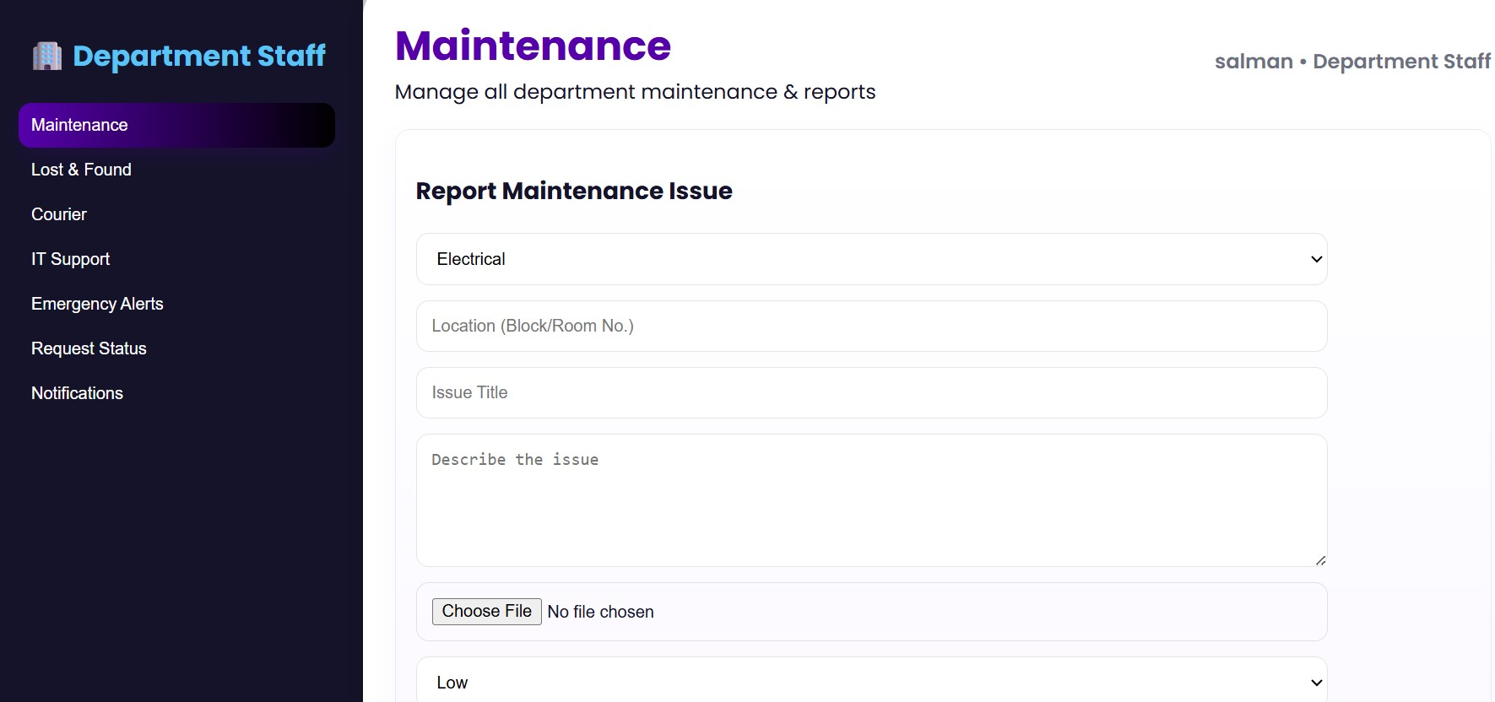

Slide 13
5. INTERNAL STAFF DEPARTMENTS & THEIR RESPONSIBILITIES
Department | Handles | Data Filter Keyword
Lost & Found Desk | Lost item reports from all roles | category: "Lost & Found"
Maintenance Staff | Repairs, lights, projectors, labs | category: "Maintenance"
Medical Staff | Emergencies, first aid | category: "Emergency"
Courier Desk | Item/document transfers | category: "Courier"
IT Staff | Technical, system errors | category: "System Issue"
Info Desk Staff | General public inquiries | category: "Inquiry"
Security | Public alerts, safety issues | category: "Security"
Admin / Management | All suggestions, escalations | category: "Suggestion" / "Complaint"

Slide 14
Logged-In Role | What They See
Student | Only their own requests
Teacher | Their own + student-related issues (read-only)
Staff | Requests where `receiver` matches their department
Admin | All requests from every role
Public | Only their own inquiries
Summary of Communication Network
STUDENT ─► Faculty Staff, Lost Desk, Medical, Courier, Maintenance
TEACHER ─► Maintenance, IT, Medical, Admin
STAFF ─► Admin / Higher Authority (Escalation)
PUBLIC ─► Security, Info Desk, Admin

